Slide 1
OZONE Q&A

Slide 2
Agenda
Introduction
Product Overview
Terminology change
Product Integration
Feature Improvements
Browser Support
Database Support
Framework upgrades
Points-of-Contact

Slide 3
Introduction
The intent of this document is to identify advancements to the OZONE products since the last FOSS release.

Slide 4
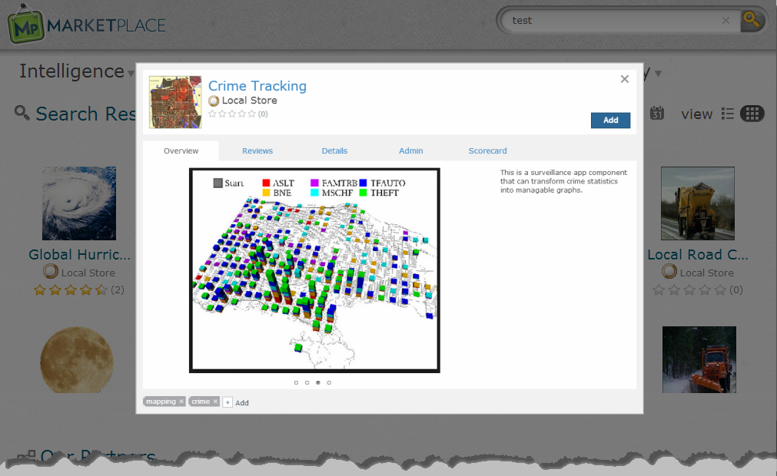
Clarifications
The terms Marketplace, OMP and the Store are used interchangeably.
Screen Resolution Recommendation: 1280x1024

Slide 5
Terminology Change
Nomenclature was modified to synchronize with standard mobile device terminology, OZONE 7.3 changed the following: terms:
Current Term | Previous Term | Definition
Application/App | Stack | Apps can compile resources and make them easy to access. They allow administrators and users to group App Pages into folder-like collections that allow for easy transition from one page to another.
App Page | Dashboard | App Pages have customizable layouts that organize app components and improve users’ workflows.
App Component | Widget | A lightweight, single-purpose Web application that offers a summary or limited view of a larger Web application. It is a global description for a piece of Web content that can be configured by the user and displayed within an application.
App Builder | Dashboard Designer | A tool in OWF where users can create or edit their own customized App Pages.

Slide 6
Development Precept
OZONE Development for version 7.x enhancements was performed with the following constraints:
Delivered features that functioned in three scenarios:
  Integrated OZONE workflow: OWF and Marketplace running together
  Standalone OWF instance
  Standalone Marketplace instance
Delivered usable features at the end of each sprint
  All UI components functioned at the end of each two-week sprint; when applicable, backend coding and testing was completed 1 sprint ahead of a features introduction to the UI
    This allowed for continuous integration of new features on a two-week cycle

Slide 7
Product Overview
Purpose:
  Marketplace enables users to search, discover, create and use a variety of applications or software components that are known as “listings.”
  OWF, a framework for the applications, allows users to create custom layouts and workflows. OWF enables the exchange of information from different agencies. Data from different servers communicate inside the browser without sending data back to each respective server.

Slide 8
Product Overview
When used together OWF & Marketplace fulfill a user’s need for:
Search & Discovery
Find Listings in the Store. Listings can be any kind of tool you need to do your job from Apps and App Components to Web Apps or plug-ins.
Content Management
Organize tools into workflows that make your work easier and more productive. Add tags to establish your own organization system; share with other users.
Building Apps
Create custom workflows for any task that you need to do.

Slide 9
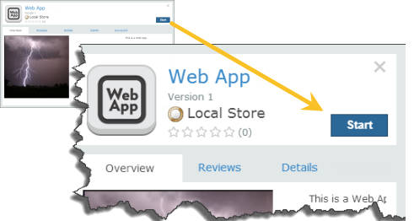
Product Integration
Can I use these products independently?
  Yes – You can use OWF or the Store independently .
Can I integrate the products?
  Yes – Improved sync and launching functions enhanced the ease of use in an integrated OZONE environment.
    Sync
    Launching OZONE Apps, Web Apps and App Components from the Store

Slide 10
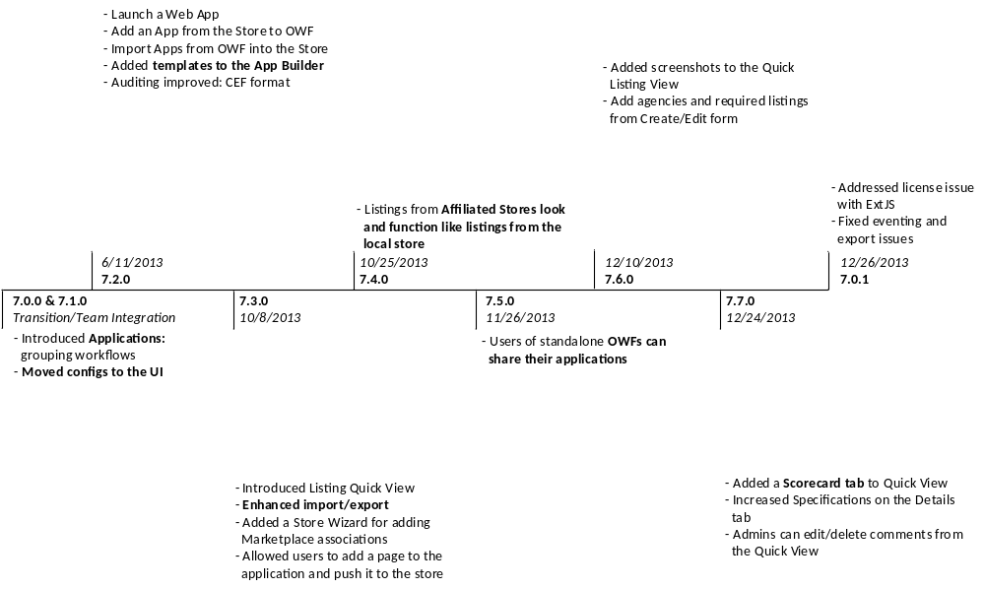
Feature Improvements

Slide 11
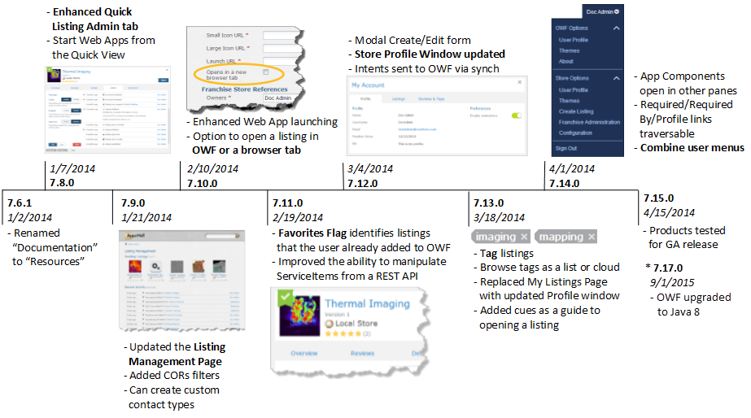
Feature Improvements

Slide 12
Framework Upgrades
CORS
  OWF and Marketplace now support cross-origin resource sharing (CORS).
    This allows the products to support newer browsers (IE10+, etc.) and query/use modern technology (HTML5, etc.).
Grails 2
  Both products will upgrade to Grails 2 for the FOSS release.
    Grails 2 includes more than 937 bugs/features/tasks closed since the version of Grails OZONE currently uses.
    It will make the project more secure and improve developers’ ability to extend the platform.

Slide 13
Browser Support
FOSS 7.15.1 release testing
  IE (smoketest 10 & 11)
  FF (smoketest current release)
  Chrome: current release

Slide 14
Product Integration
Backward Compatibility
The products was tested for compatibility with the following versions:
  OWF 7.3 and 7.0.1
  Marketplace 7.3 and 5

Slide 15
Database Support
FOSS 7.15.1 release testing
  MySQL
  Oracle
  PostgreSQL
  SQL Server

Slide 16
Points of Contact
OZONE Points-of-Contact:
  Google Forum
    You must request access.
    https://groups.google.com/forum/#!forum/ozoneplatform-users
  Stack Exchange
    http://area51.stackexchange.com/proposals/82636/ozone-platform

Slide 17
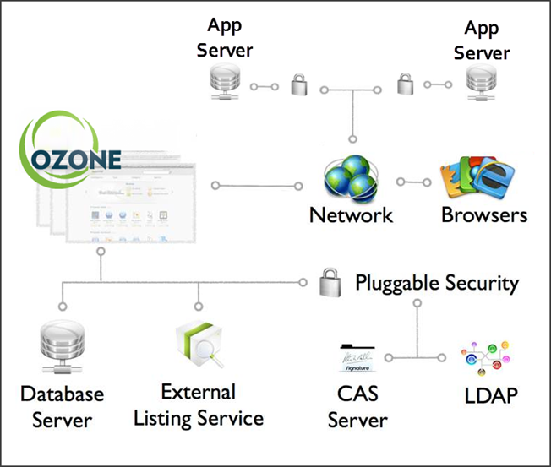
Basic System Architecture

